Slide 1

Fundamentals
With C#
October 2016
The Unity game engine is one of the most popular and rapidly growing cross-platform game development platforms. It has gained such popularity primarily due to being easy to use, yet powerful enough to create many great robust games and applications you've probably heard of: Rust, Kerbal Space Program, Hearthstone, Cities Skylines, and many more games that have sold hundreds of thousands of copies. Join us in learning the basics of Unity so you can make your own Games/Virtual Reality Experiences/Augmented Reality Apps and much more!
Andrew Ribeiro

Slide 2

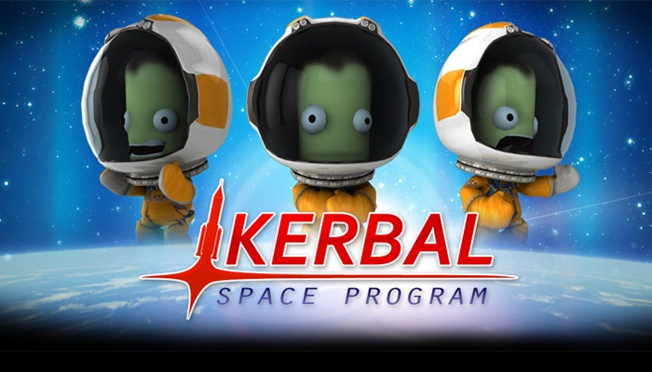
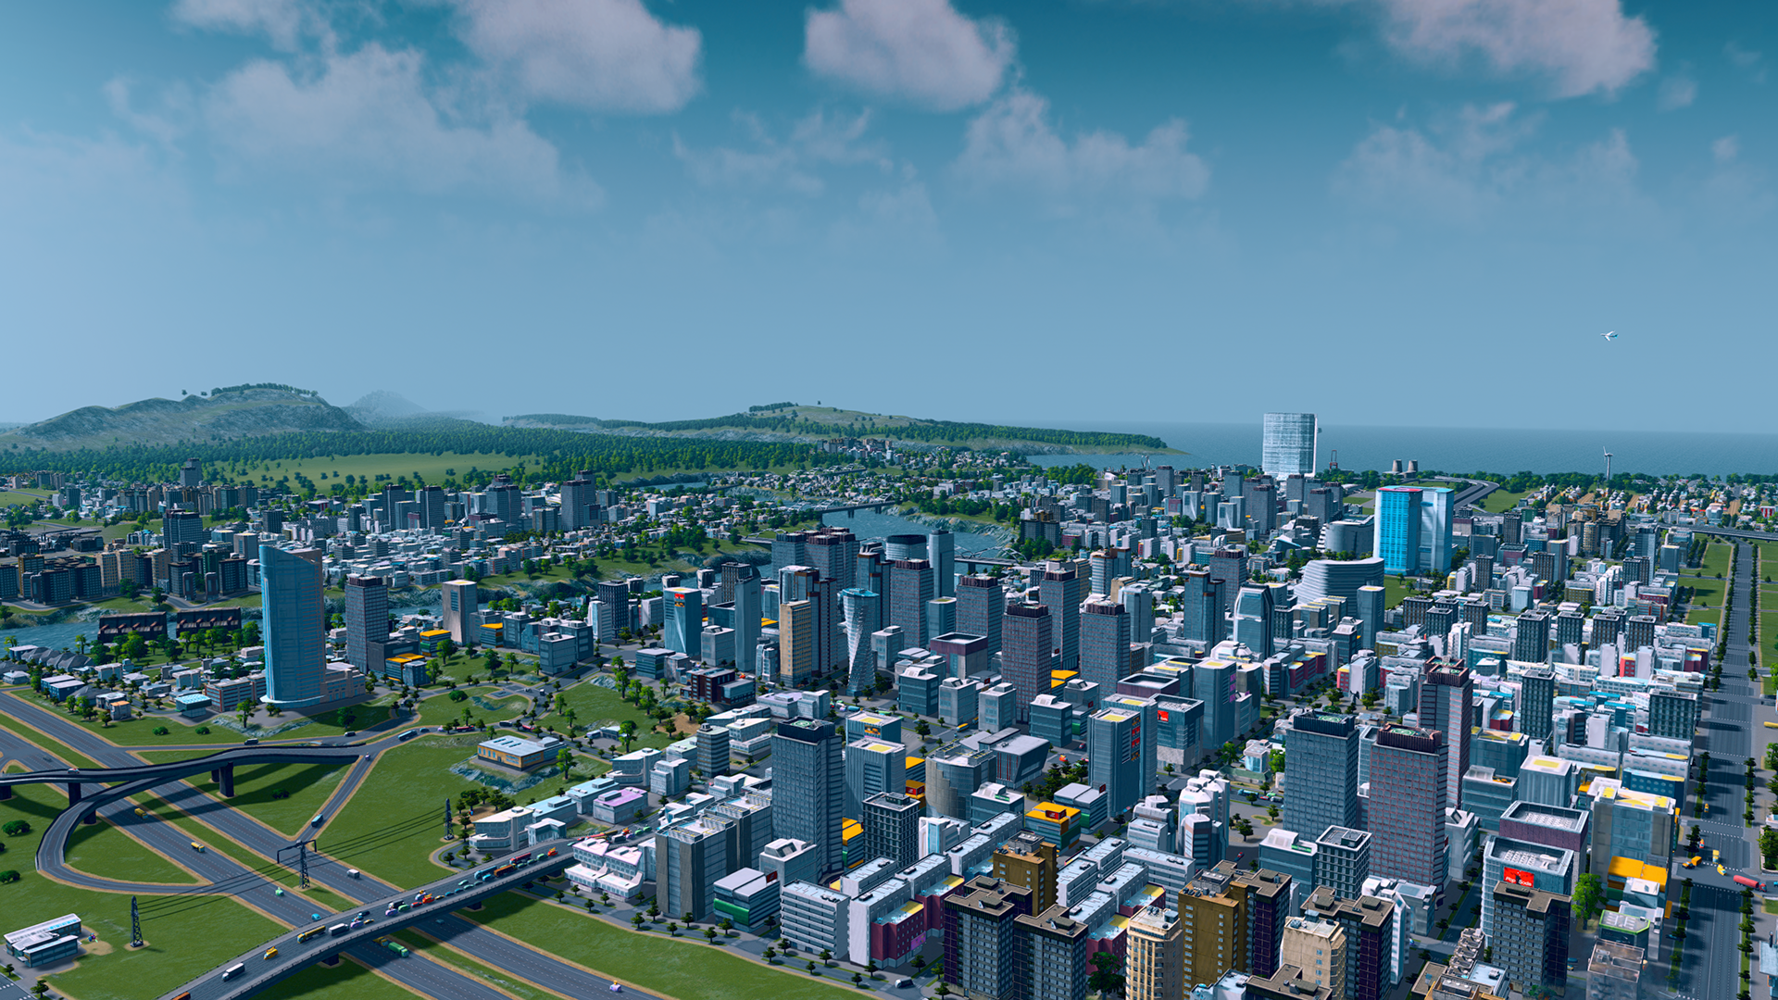
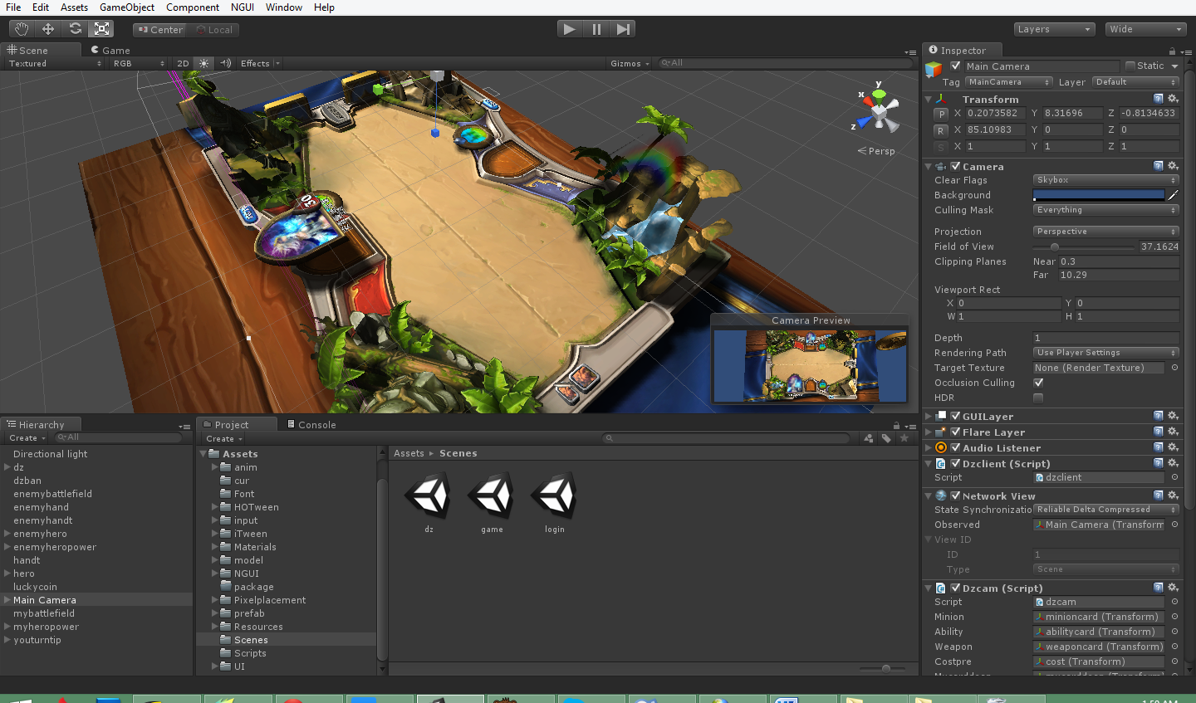
Overview
Motivation and About Unity
The Unity Interface
Scenes
Game Objects and Components
Assets
Cameras
Lighting
Input
Basic Physics
Basic Builds
Practical Unity
Scripting in C#

Slide 3
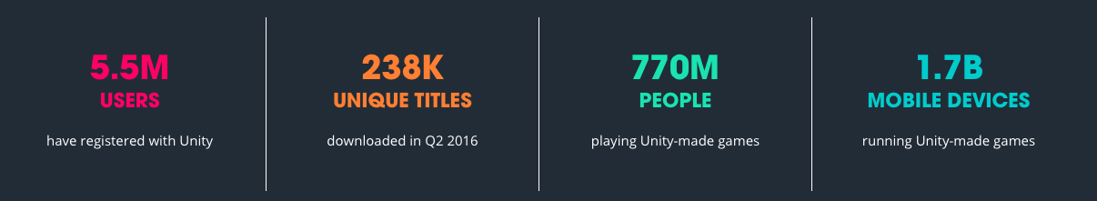
Motivation
There have been many commercially successful games developed with Unity.
Unity has a simple and intuitive interface and way of doing things.
Develop once deploy everywhere! ( Except web in some cases, but they are working on it! )
Cutting edge technologies use unity as their SDK or support it. VR!
Supports 3D and 2D games.
Notes:
Unity Web Player depreciated due to WebGL adoption.

Slide 4
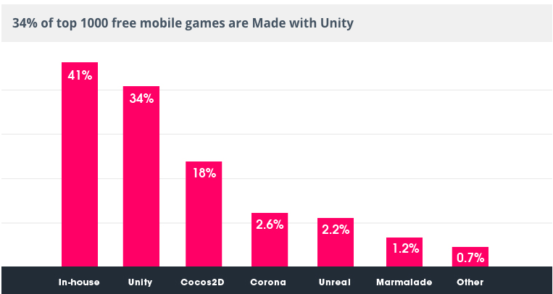
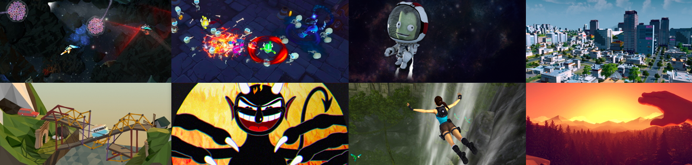

Slide 5
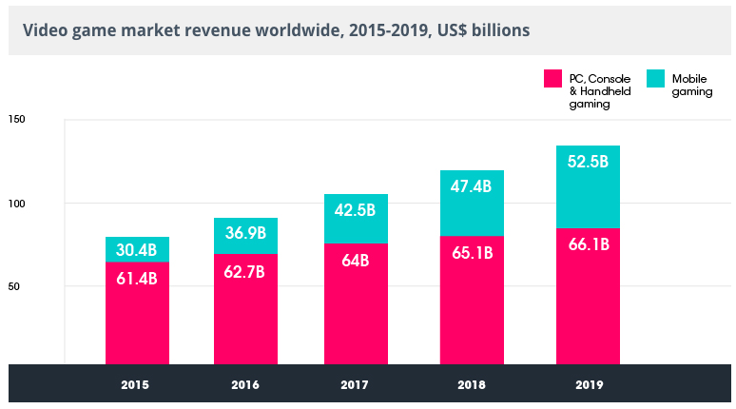
AKA Why a Mobile Centric Engine is Important

Slide 6
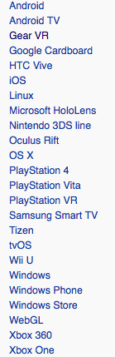

About Unity
One of the largest Game Development communities!
Supports 3D and 2D games.
Develop Unity games on Windows and OS X ( Experimental Linux Version ).
Supports super easy VR dev.
It’s super hot right now.
Still hasn’t released a WebGL version.
Scripting: JavaScript & C#
Royalty Free! ( See fine print )
Current Version: 5
Initial Release: 1.0 / June 8, 2005; 11 years ago
Cross-platform deployment.
Written in C++
Over 1,000 employees.
Notes:
Version 5 March 2015
Latest stable: 5.4.1 / July 28, 2016; 2 months ago
Unity Script - The JavaScript version for Unity.
Unity is the default software development kit (SDK) for Nintendo's Wii U video game consoleplatform, with a free copy included by Nintendo with each Wii U developer license. Unity Technologies calls this bundling of a third-party SDK an "industry first".^{[8][19]}

Slide 7
Before we begin...............................Some Cool Unity Services
Unity Multiplayer - Implement Multiplayer features easily with concurrent users hosted by Unity. Full access to high/low level APIs. Take advantage of Unity-hosted features; Relay Server and Matchmaker Server.
Unity Analytics - Gain immediate insights into players’ behavior across multiple platforms. Improve gameplay experience and optimize monetization with insights from Unity Analytics, the only analytics solution that is natively integrated into the Unity engine and built specifically for games.
Unity Cloud Build - Automate your workflow. Create builds automatically, as changes are dedicated. Easily share builds with your team.
Unity Ads - The premier ad monetization solution for mobile games. Cool modern features like incentives to watch ad videos for game rewards.
Subscription Services
Performance Reporting - Automatically capture app errors across devices, platforms, and builds. Prioritize issues as they're reported in real time.
The main difference between personal and the various subscription plans is:
You are limited to 20 concurrent users with Unity Multiplayer in the free plan. You can always use your own server architecture to overcome this!
You can’t customize the splash screen in the personal version.
Longer wait times when using cloud build.

Slide 8

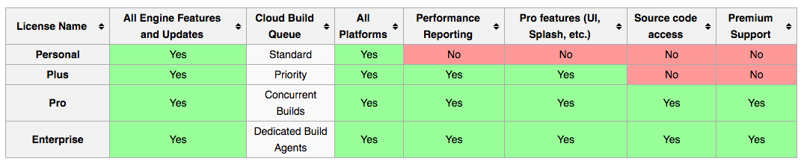
Unity Licensing
The licence model will not be an issue for small/indie developers making less than $100,000 a year. If you make over that sum, the licence requires a low subscription fee per month/seat.
See: https://store.unity.com/

Slide 9
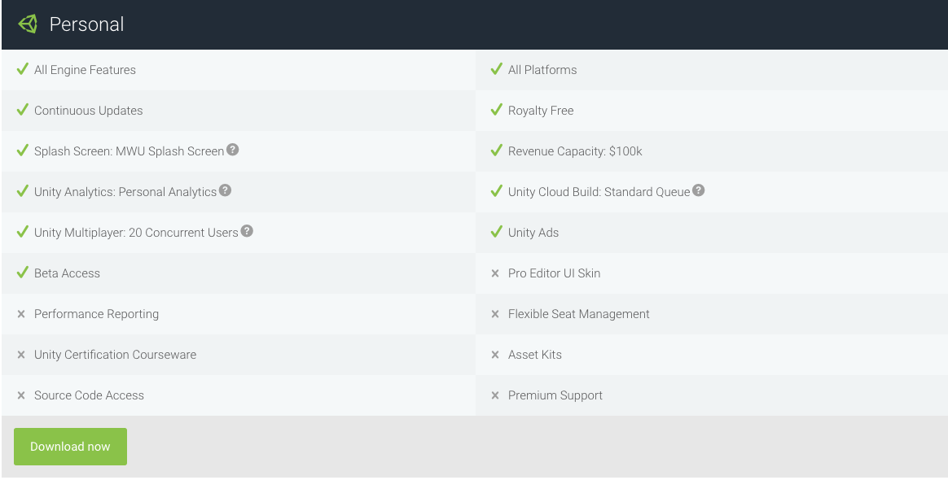
Unity Licensing
Only Gripe

Slide 10

The Unity Interface
( I use the recommended 2 by 3 layout )
Scene View - Visually manipulate game objects in 3D or 2D.
Game View - Preview your game. Becomes active when you press play. Can be controlled with the game view controller.
Hierarchy Window - Each item in the scene has an entry in the hierarchy, so the two windows are inherently linked. The hierarchy reveals the structure of how objects are attached to one another.
Project Window - Displays your library of assets that are available to use in your project.
Inspector Window - Context sensitive menu that allows you to view and edit all the properties of the currently selected object.

Slide 11
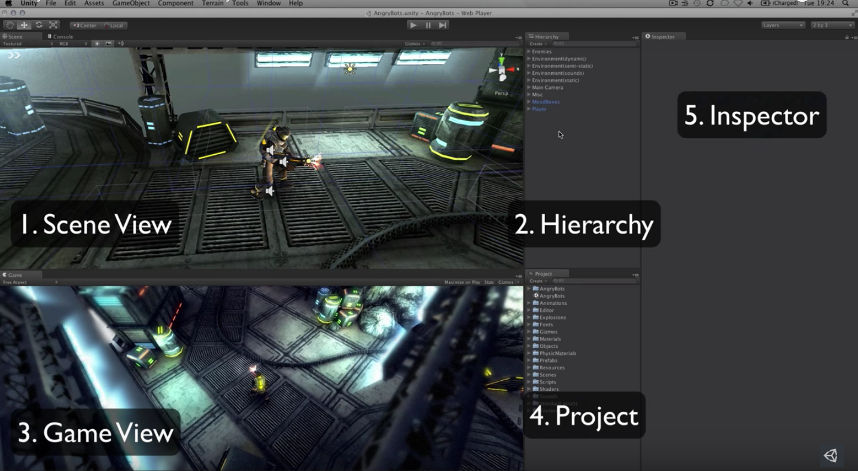

Slide 12
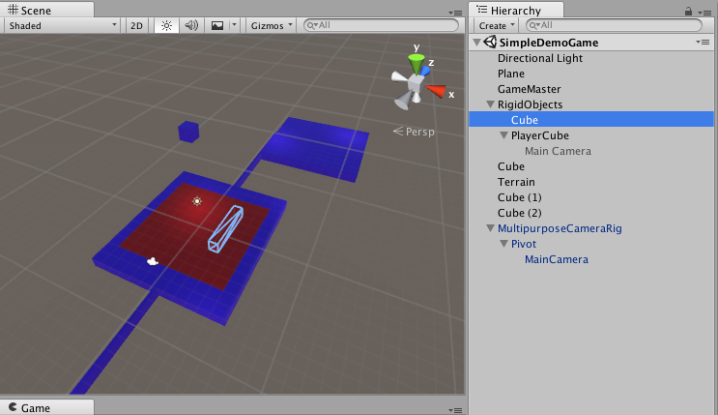
Hierarchy Tree

Slide 13
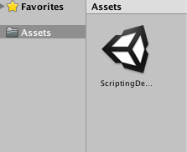
Scenes
Scenes contain the objects of your game. They can be used to create a main menu, individual levels, and anything else. Think of each unique Scene file as a unique level.
When you save a scene as, it shows up in your assets folder and looks like this:
It’s possible to have multiple scenes open at once. Usually not necessary though.

Slide 14
Moving Around a Scene
Panning
Zoom
Rotation
GameObject camera lifesavers.
GameObject > Move to View
GameObject > Align With View
GameObject > Align View to Selected
Let’s Play Around a Bit

Slide 15
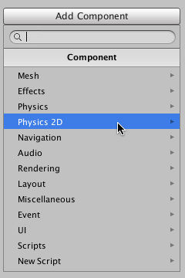
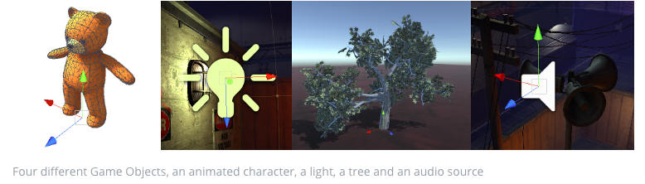
Game Objects and Components
GameObjects are containers. They can hold the different pieces that are required to make up a character, a light, a tree, a sound, or whatever else you would like to build.
Components define the behavior of game objects.
There are many prefabricated components available for our use. When we write scripts, we are usually defining a component which can be attached to some GameObject..
Notes:
Active vs Inactive objects.

Slide 16
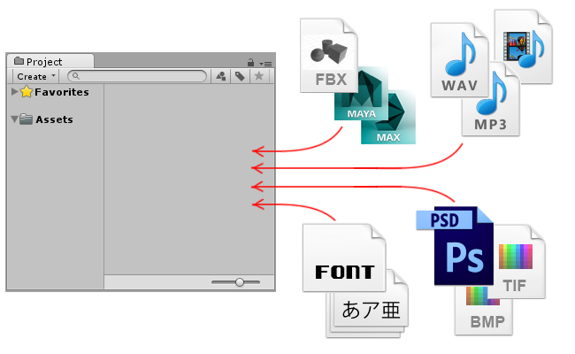
Assets
An asset is representation of any item that can be used in your game or project. An asset may come from a file created outside of Unity, such as a 3D model, an audio file, an image, or any of the other types of file that Unity supports. There are also some asset types that can be created within Unity, such as an Animator Controller, an Audio Mixer or a Render Texture.
Notes:
Prefab asset type that allows you to store a GameObject object complete with components and properties. The prefab acts as a template from which you can create new object instances in the scene. Any edits made to a prefab asset are immediately reflected in all instances produced from it but you can also override components and settings for each instance individually.

Slide 17
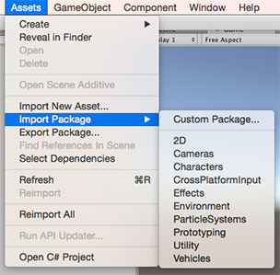
Standard Asset Packages
Provided by Unity for royalty free use and comes with the most common cameras, and prefabricated game objects

Slide 18
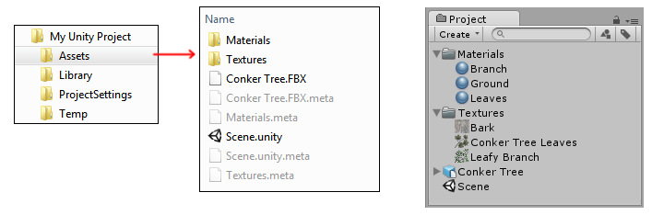
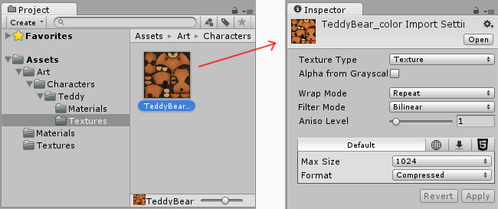
Importing Assets
Notes:
FBX or .OBJ are the main 3D object types. But it supports proprietary like .blend and .max.

Slide 19
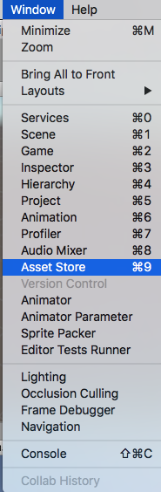
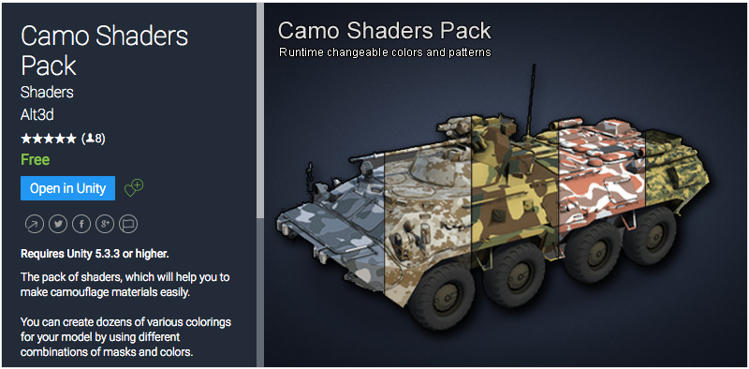
Asset Store
One of the cool things about unity is in-engine access to an asset store which allows you to add free and premium assets to your game easily. You can also sell assets you create on the store.
Notes:
One of the cool things about unity is modular reusable -- prefabs..

Slide 20
Asset Packages
Unity packages are a handy way of sharing and re-using Unity projects and collections of assets; Unity Standard Assets and items on the Unity Asset Store are supplied in packages, for example.
Packages are collections of files and data from Unity projects, or elements of projects, which are compressed and stored in one file, similar to Zip files. Like Zip files, a package maintains its original directory structure when it is unpacked, as well as meta-data about assets (such as import settings and links to other assets).
Often different SDK’s have packages for you to import into your project for interop.

Slide 21
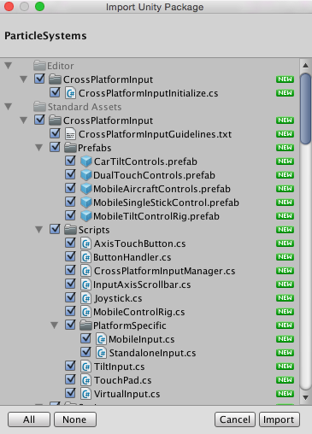

Slide 22
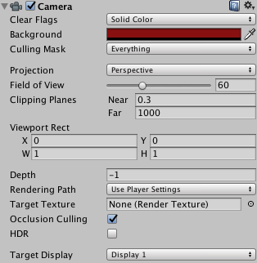
Cameras
It’s often helpful to use prefabricated cameras that are coded for particular uses.
Clear flags
A camera can’t leave the background completely undecided and so it must fill in the empty space with something.
Culling Mask
What layers are visible to this camera.
Projection
Orthographic
Perspective
Field of View
Clipping Planes
Where we start hiding the geometry.
Depth
Occlusion Culling
Target Display
Notes:
Can be animated. Cameras can be switched.
cam1.enabled = true;

Slide 23
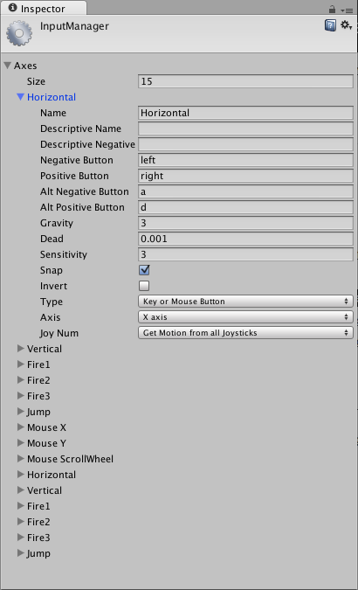
Input
Unity has a robust input system which supports controllers, keyboard, mouse, and mobile inputs like accelerometers and multi-touch.

Slide 24
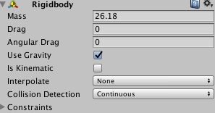
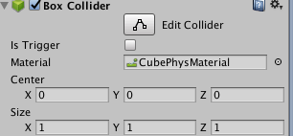
Basic Physics
Colliders
Add physics materials with custom defined properties.
Primitive colliders like Cube, Sphere, and also custom mesh colliders.
The RigidBody component adds physics easily to objects.

Slide 25
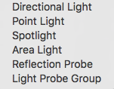
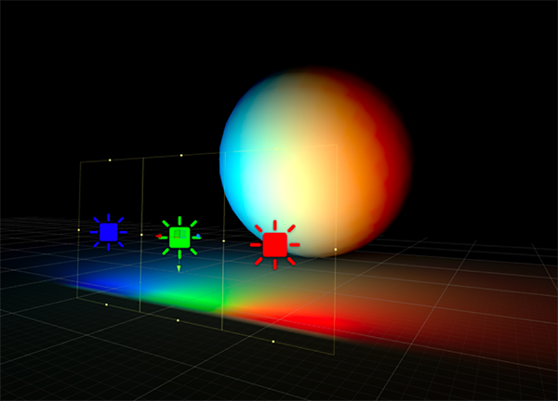
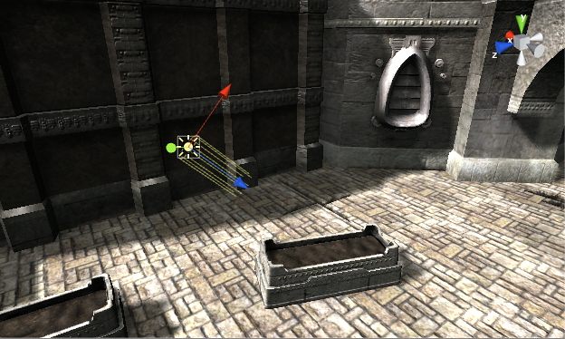
Lighting
Ambient light is light that is present all around the scene and doesn’t come from any specific source object. It can be an important contributor to the overall look and brightness of a scene.
Area Light
Area Light

Slide 26
Practical Unity
How to Do Basic Tasks

Slide 27
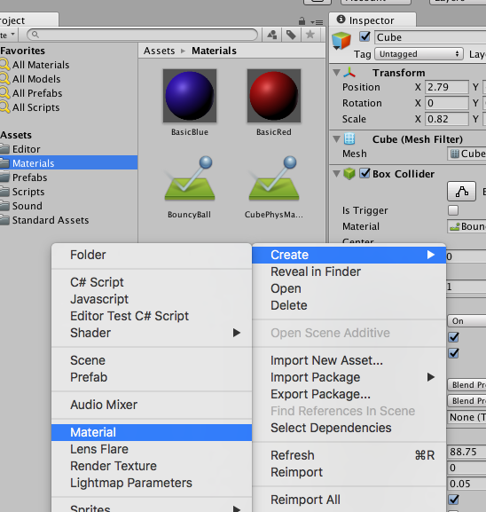
Add Textures to Objects
Right click in the assets folder and create > material. Then drag and drop the material onto the mesh you’d like to texture. Edit the property of the texture in the inspector panel.

Slide 28
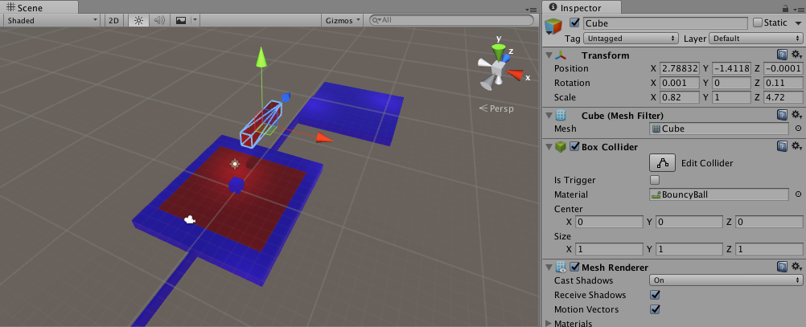
Make Real Time Edits
You can change the properties of components, code, and manipulate the object hierarchy in any way you’d like when the game is playing.
Your changes will not be persisted when the game is stopped.

Slide 29
Create Prefabs
Right click on assets folder, create > Prefab.
Create new object you’d like to store as a prefab. Drag and drop that object onto the blank prefab you just created.
Edit the prefab via inspector while selected in the asset viewer.

Slide 30

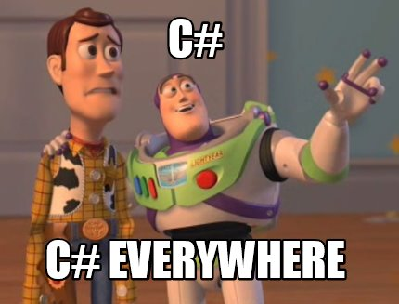
Unity Scripting

Slide 31

A Few Quick Notes
In a single project you can have multiple scripts written in both UnityScript ( JavaScript ) or C#.
This is great for small teams of developers who have different coding preferences... although I’d stick with a single language for consistency's sake.
Unity Comes with MonoDevelop and is the default script editor. Unity can be configured to use Visual Studio instead if that’s your goto IDE.
The parent object of every script is MonoBehaviour. In C# we explicitly inherit it. In UnityScript it is implicitly inherited.
https://docs.unity3d.com/ScriptReference/MonoBehaviour.html

Slide 32
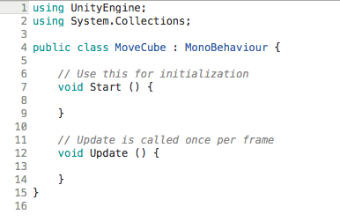
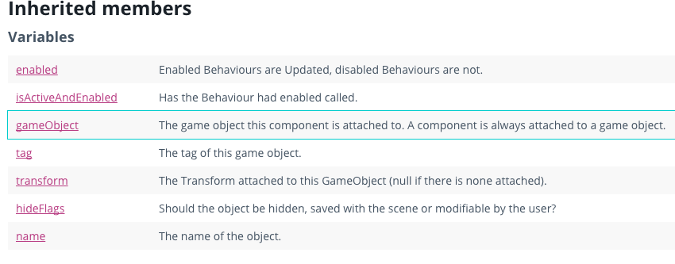
The Script Template

Slide 33
Finding Objects
By tags.
respawns = GameObject.FindGameObjectsWithTag("Respawn");
By object names.
GameObject.Find("Hand");

Slide 34
Movement
If you are moving a rigid body, you must use forces or adjust the rigid body’s velocity to interact properly with other physics object ( colliders ).
Otherwise you can use object translation to move an object.

Slide 35
See the Demo Code
Available On Github

Slide 36
Resources & Sources

Slide 37
Links
Basic Info and Links
https://unity3d.com/
https://en.wikipedia.org/wiki/Unity_(game_engine)
https://unity3d.com/public-relations
https://store.unity.com/ ( Licencing Info )
Main Links
https://www.assetstore.unity3d.com
Good Basic Tutorials
https://unity3d.com/learn/tutorials/projects/tanks-tutorial/tank-creation-control?playlist=20081
Creating prefabs: https://www.youtube.com/watch?v=HECGcwwRM64

Slide 38
Scripting Links
Scripty Stuff
https://docs.unity3d.com/Manual/ControllingGameObjectsComponents.html
https://docs.unity3d.com/Manual/InstantiatingPrefabs.html
Animation
Smoothing: https://unity3d.com/learn/tutorials/topics/scripting/delta-time
Input
https://docs.unity3d.com/Manual/MobileInput.html
Physics
https://docs.unity3d.com/Manual/class-MeshCollider.html
https://unity3d.com/learn/tutorials/topics/physics/bouncing-ball

Slide 39
Questions?
Interested in Artificial Intelligence? Join us at DanburyAI.
https://www.meetup.com/DanburyAI/
AndrewNetwork@gmail.com
https://github.com/Andrewnetwork/UnityFundamentalsOctober2016

Slide 40
Unused Slides

Slide 41
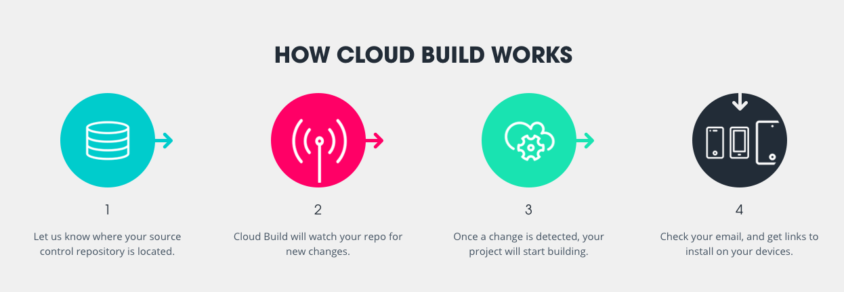
Unity Cloud Build

Slide 42
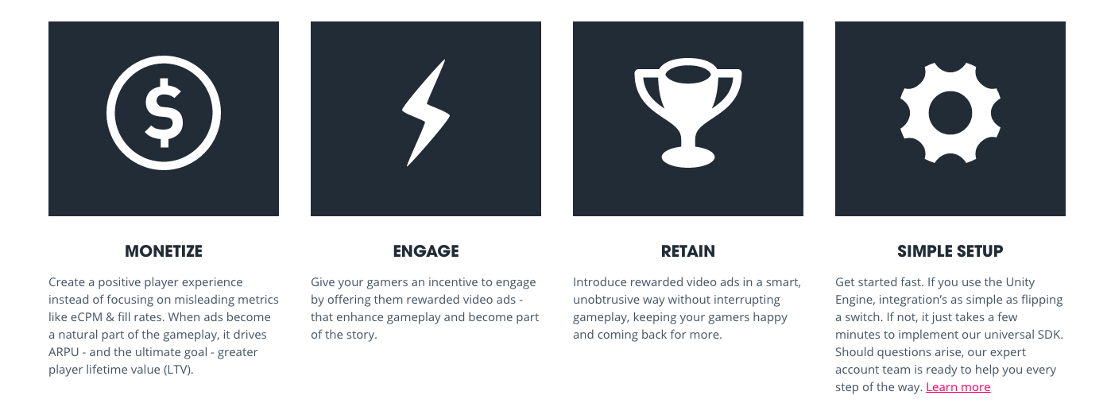
Unity Ads

